Slide 1

IR Project – Fall 2021
Eyal Maor – 322892878 Idan Bibi – 211375746
eyalmao@post.bgu.ac.il idanbib@post.bgu.ac.il

Slide 2

What will we show today?
Creating the inverted index of the title, body text and anchor text
Creating the Page rank (PR) method and Page views (PV)
Creating the required search functions
Creating the main search function
Evaluate the search engine performance on difference search methods

Slide 3
Inverted Index, page view and page rank
We created Inverted Index on the entire Wikipedia corpus. The creation of the inverted index mostly based on practical hw3, and we added some methods which helped us to work on a giant corpus data.
We made three Inverted Index for each part of a Wikipedia document – a Title Inverted Index , a body text Inverted Index and an anchor text Inverted Index . The Inverted Index is on the entire corpus.
We saved a json file doc_lengths with the length of each file (DL)
We created json file (page_rank_data) which stores the PR of each doc in the corpus
In addition, we made two pikle file (pageviews, id_title_dict) which pageviews based on hw1 which stores the views of the doc for each doc in the corpus and id_title_dict which each record represents the doc’s id and what is the title of the doc.

Slide 4

Search functions
For working with the search functions, we created some functions for making the search available:
Tokenize – a functions which makes tokens from the query we got from the user.
Read_posting_list – the function reads the posting list of one single word token we searched in the query.
Tfidf_func - Returns a sorted list of documents id's according to tf-idf score
Get_docs_binary - Returns ALL (not just top 100) search results that contain A QUERY WORD IN THE TITLE OR ANCHOR of articles, ordered in descending order of the NUMBER OF QUERY WORDS that appear in the title. For example, a document with a title that matches two of the query words will be ranked before a document with a title that matches only one query term.
We used a combination of those function together and adjusted the combination for each type of a search function (search_title, search_body, search_anchor).

Slide 5


Our main Search function
This is the main function that returns up to a 100 of your best search results for the query. We used word embedding word2vec which we loaded beforehand (wiki-news-300d-1M.vec).
We used a combination of most functions we mentioned a slide before, and in addition we used two more functions:
Expand_query – a function which returns a new list of expended tokens.
Sim – a function that filtering the words that are not like others and calculating the similarity between different tokens in the query.
The main function activate the combination of functions and returns the most relevant docs.

Slide 6
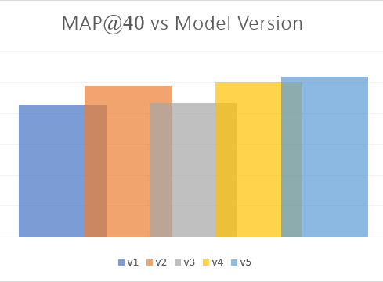

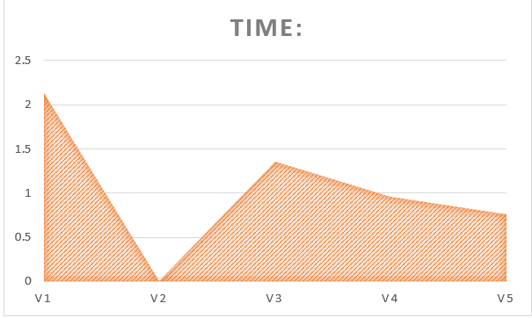
Evaluate the search engine performance on difference search methods
A graph showing the engine performance for each major version of your implementation:
A graph showing the engine's average retrieval time for each major version of your implementation

